Slide 1

Writing PowerShell The right tool for the job
Jaap Brasser
@jaap_brasser

Slide 2


PowerShell Conference Asia
Dutch PowerShell User Group
Blogging
MS Tech Communities
Slack
Reddit
GitHub
PowerShell Gallery
TechNet Forums/Gallery
@Jaap_Brasser
whoami.exe /priv

Slide 3
Agenda
Differences in tools
Configure VS Code
Working with VS code
Working with the ISE and ISESteroids
Questions

Slide 4

Agenda
Differences between editors
Configure VSCode
Working with Vscode
Setting up the ISE
Working with the ISE and ISESteroids
Questions
IDE, ISE, Editors?

Slide 5

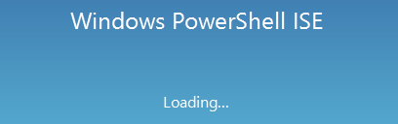


Tools, what tools?

Slide 6
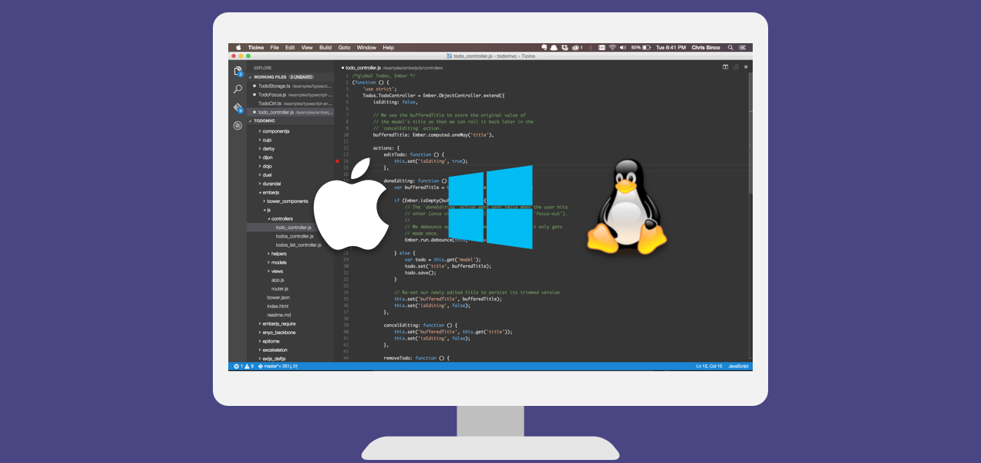
Agenda
Differences between editors
Configure VSCode
Working with Vscode
Setting up the ISE
Working with the ISE and ISESteroids
Questions
Visual Studio
Code

Slide 7
VS What?
Open source
Actively developed by Microsoft
Multi platform

Slide 8
Important config files
%userprofile%\AppData\Roaming\Code\User\keybindings.json
%userprofile%\AppData\Roaming\Code\User\settings.json

Slide 9
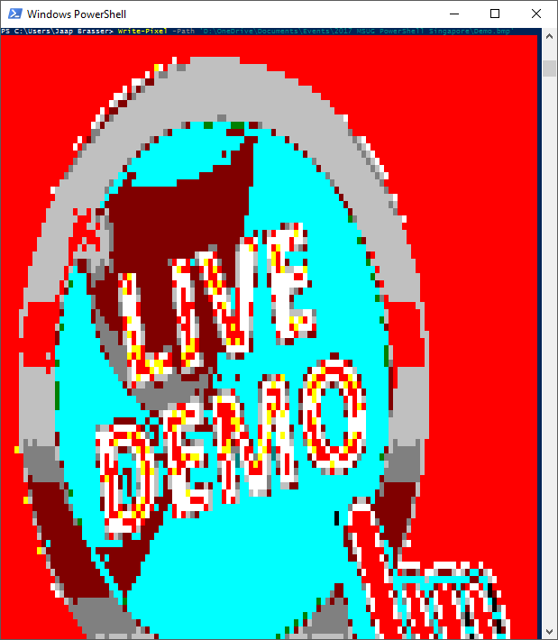
Agenda
Differences between editors
Configure VSCode
Working with Vscode
Setting up the ISE
Working with the ISE and ISESteroids
Questions
Demo
VS Code

Slide 10
Demo Summary
Configure Split screen
File compare
Create custom key bindings
Run a single line of code
Multi line selection
Select all words in file
Commit and push to GitHub
Enable Minimap
Set a theme
Jump to file

Slide 11

Agenda
Differences between editors
Configure VSCode
Working with Vscode
Setting up the ISE
Working with the ISE and ISESteroids
Questions
Steroids…

Slide 12

What is ISE Steroids
A Module for the PowerShell ISE
Developed by Tobias Weltner
Available in the PowerShell Gallery
Contains PSSharper
@TobiasPSP

Slide 13
ISE Features
Edit your PowerShell Profile
Create Executable from PowerShell script
Built-in compatibility checking
Extensibility using MyCommands or plugins

Slide 14
ISE Features continued…
Smarter F8-behaviour
Automatic script formatting
Script obfuscation
Automatic error handling

Slide 15
Agenda
Differences between editors
Configure VSCode
Working with Vscode
Setting up the ISE
Working with the ISE and ISESteroids
Questions
Demo
ISE and ISESteroids

Slide 16
Demo Summary
Install ISESteroids
Edit PowerShell Profile
Create .exe from script
Compatibility checking
Function in MyCommands
Smarter F8 behaviour
Fix up ugly scripts
Script Obfuscation
Automatic error handling
Syntax to Function

Slide 17

Summary

Slide 18

Differences between editors
Configure VSCode
Working with Vscode
Setting up the ISE
Working with the ISE and ISESteroids
Questions
Questions

Slide 19
Resources
https://github.com/Microsoft/vscode
https://code.visualstudio.com/
https://github.com/Microsoft/vscode-tips-and-tricks
http://www.powertheshell.com/
http://www.powertheshell.com/category/blog/
http://code52.org/carnac/
https://github.com/jaapbrasser/Events/tree/master/MSUGSingapore2017-03-18

